Slide 1

Data Visualization
Lecture 6
Data Cleaning & Pre-Processing
14/03/2022

Slide 2
Missing Values
One of the realities of analyzing and visualizing “real” data sets is that they often are missing some data entries or have erroneous entries.
Missing data may be caused by several reasons, including, for example, a malfunctioning sensor, a blank entry on a survey, or an omission on the part of the person entering the data.

Slide 3
Contd.
Erroneous data is most often caused by human error and can be difficult to detect.
In either case, the data analyst must choose a strategy for dealing with these common events. Some of these strategies, specifically those that are commonly used in data visualization, are outlined below

Slide 4
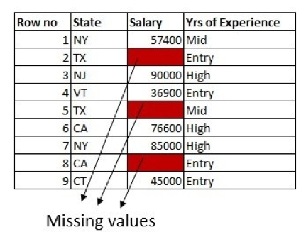
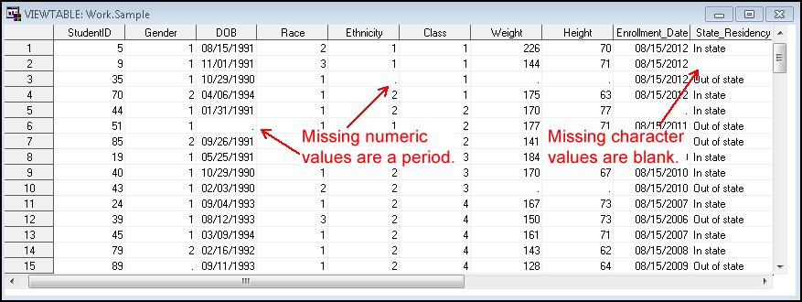
Missing Data Sample

Slide 5
Discard the bad record
This seemingly drastic measure, namely to throw away any data record containing a missing or erroneous field, is actually one of the most commonly applied, since the quality of the remaining data entries in that record may be in question.
However, this can potentially lead to a significant loss of information, especially in data sets containing large numbers of records. In some domains, as much as 90% of records have at least one missing or erroneous field.
In addition, those records with missing data may be the most interesting (e.g., such as due to a malfunctioning sensor or an overly high response to a drug)

Slide 6
Assign a sentinel value
Another popular strategy is to have a designated sentinel value for each variable in the data set that can be assigned when the real value in a record is in question.
For example, in a variable that has a range of 0 to 100, one might use a value such as −5 to designate an erroneous or missing entry.
Then, when the data is visualized, the records with problematic data entries will be clearly visible. Of course, if this strategy is chosen, care must be taken not to perform statistical analysis on these sentinel values.

Slide 7
Contd.
A | B | C | D | E | F | G
10 | 90 | 42 | 56 | -25 | 78 | 100
A | B | C | D | E | F | G
10 | 90 | 42 | 56 | 0 | 78 | 100

Slide 8
Sentinel Data

Slide 9
Assign the average value.
A simple strategy for dealing with bad or missing data is to replace it with the average value for that variable or dimension.
An advantage to using this strategy is that it minimally affects the overall statistics for that variable. The average, however, may not be a good “guess” for this particular record.
Another drawback of using this method is that it may mask or obscure outliers, which can be of particular interest.

Slide 10
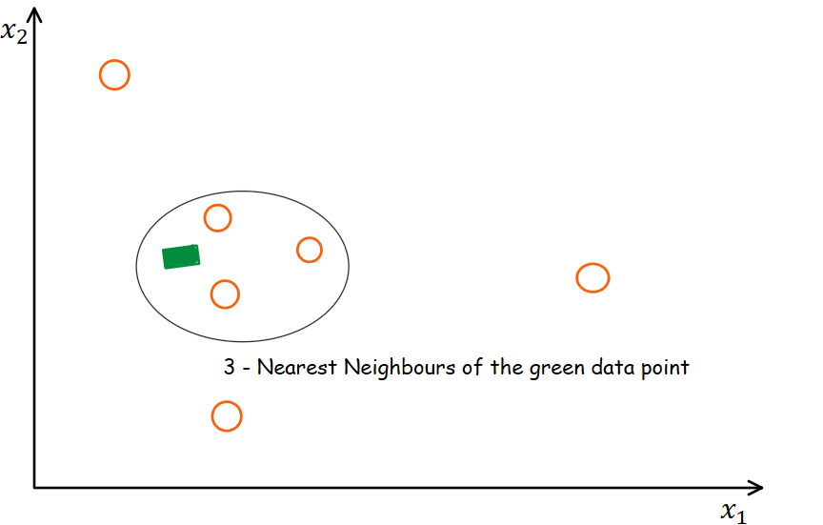
Assign value based on nearest neighbour
A better approximation for a substitute value is to find the record that has the highest similarity with the record in question, based on analyzing the differences in all other variables.

Slide 11
Compute a substitute value
Researchers in multivariate statistics have dedicated a significant amount of energy to developing methods for generating values to replace missing or erroneous data.
-Mean
-Median
-Mode

Slide 12
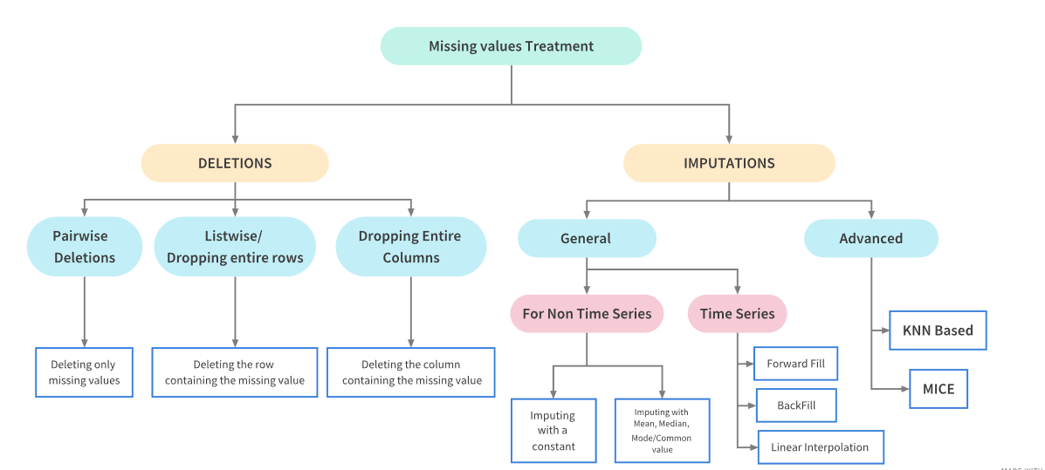

Slide 13
Normalization
Normalization is the process of transforming a data set so that the results satisfy a particular statistical property.
Let’s say we have a dataset containing two variables: time traveled and distance covered.
Time is measured in hours (e.g. 5, 10, 25 hours ) and distance in miles (e.g. 500, 800, 1200 miles). Do you see the problem?

Slide 14
Contd.
One obvious problem of course is that these two variables are measured in two different units — one in hours and the other in miles.
The other problem — which is not obvious but if you take a closer look you'll find it — is the distribution of data, which is quite different in these two variables (both within and between variables).
The purpose of normalization is to transform data in a way that they are either dimensionless and/or have similar distributions.
This process of normalization is known by other names such as standardization, feature scaling, etc. Normalization is an essential step in data pre-processing in any machine learning application and model fitting

Slide 15
How does Normalization Help
Normalization gives equal weights/importance to each variable so that no single variable steers model performance in one direction just because they are bigger numbers.
As an example, clustering algorithms use distance measures to determine if an observation should belong to a certain cluster. “Euclidean distance” is often used to measure those distances.
If a variable has significantly higher values, it can dominate distance measures, suppressing other variables with small values.

Slide 16
Contd.
For example, if dmin and dmax are the minimum and maximum values for a particular data variable, we can normalize the values to the range of 0.0 to 1.0 using the formula.
dnormalized = (doriginal − dmin)/(dmax − dmin).

Slide 17
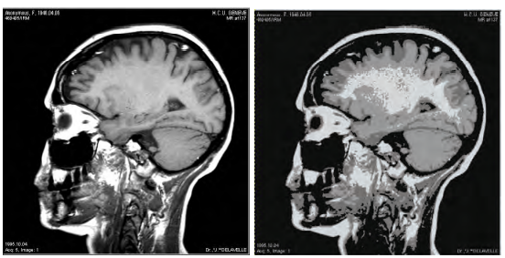
Segmentation
In many situations, the data can be separated into contiguous regions, where each region corresponds to a particular classification of the data. For example, an MRI data set might originally have 256 possible values for each data point and then be segmented into specific categories, such as bone, muscle, fat, and skin.

Slide 18
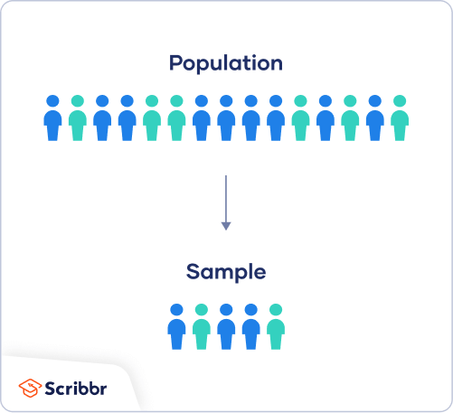
Sampling and Subsetting
Sampling is a process used in statistical analysis in which a predetermined number of observations are taken from a larger population.
The methodology used to sample from a larger population depends on the type of analysis being performed, but it may include simple random sampling or systematic sampling.
Data must be Homogenous

Slide 19
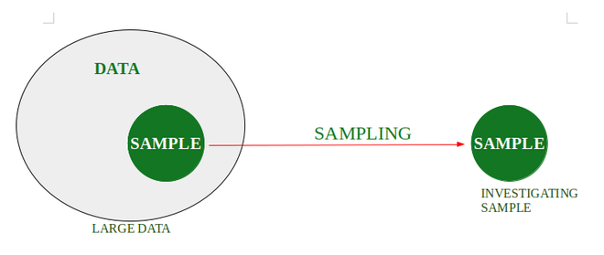
Sub-setting and Sampling

Slide 20
Linear Interpolation
The linear interpolation formula is a method that is useful for curve fitting using linear polynomials.
Basically, the interpolation method is used for finding new values for any function using the set of values.
The unknown values in the table are found using the linear interpolation formula. The linear interpolation formula is used for data forecasting, data prediction, mathematical and scientific applications, market research, etc.

Slide 21
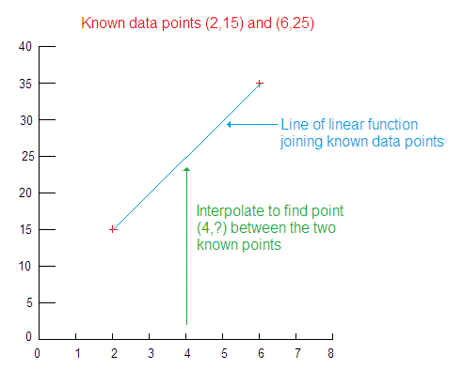
Contd.
Linear interpolation is by far the most commonly used method, as it is both easier to interpret and easier to use.
Visually, linear interpolation means drawing a secant line between the points that you know and finding the point on the line that corresponds with the value you want to know about.

Slide 22
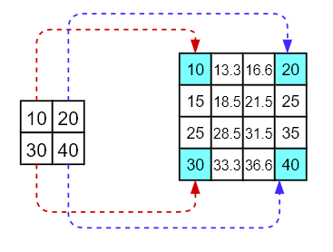
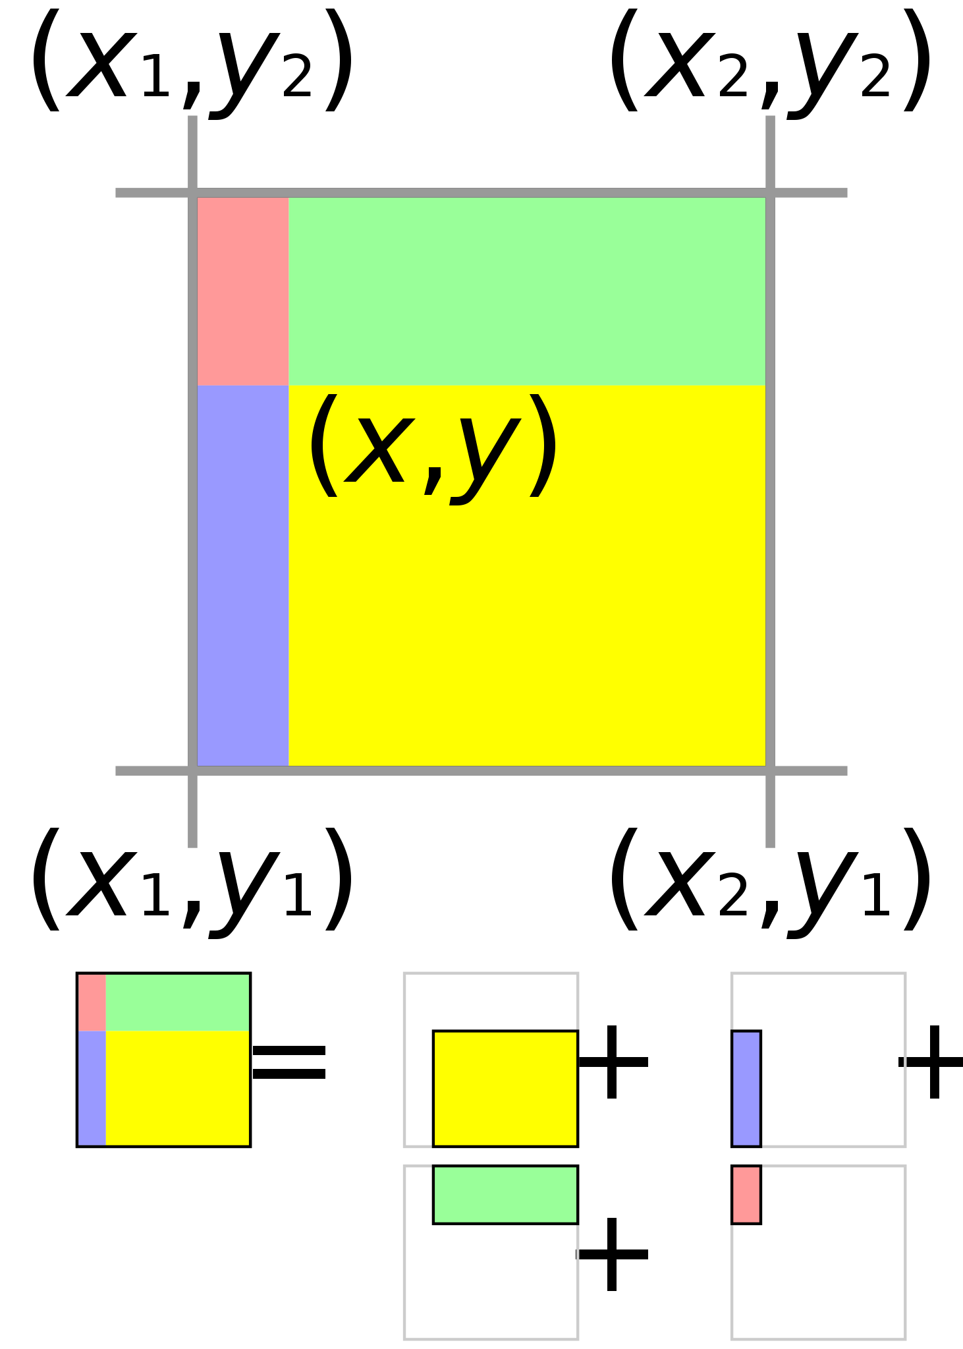
Bi-Linear Interpolation
Bilinear interpolation is a method for interpolating functions of two variables (e.g., x and y) using repeated linear interpolation.
We can extend this concept to two dimensions (or to an arbitrary number of dimensions) by repeating the procedure for each dimension. For example, a common task in two dimensions is to compute the value of d at location (x, y) given a uniform grid of data values

Slide 23
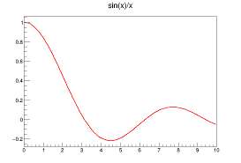
Non-Linear Interpolation
The second most popular interpolation method is an exponential interpolation. Unlike linear interpolation, which assumes a straight line interpolation pattern between known points, the exponential interpolation pattern assumes a smooth, concave curve between points.

Slide 24
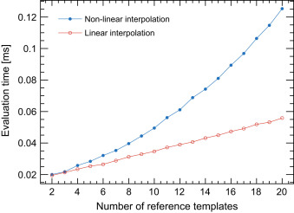
Summary
In short, interpolation is looking at estimates in between known values, while extrapolation is taking a function or model and projecting its validity outside of the range of known data.

